Slide 1
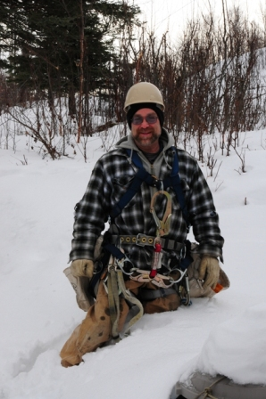
Towers and Antennas Tim Jellison W3YQ/KL7WV

Slide 2
Know what you’re getting into when planning a tower
Be safe when working on antennas and towers

Slide 3
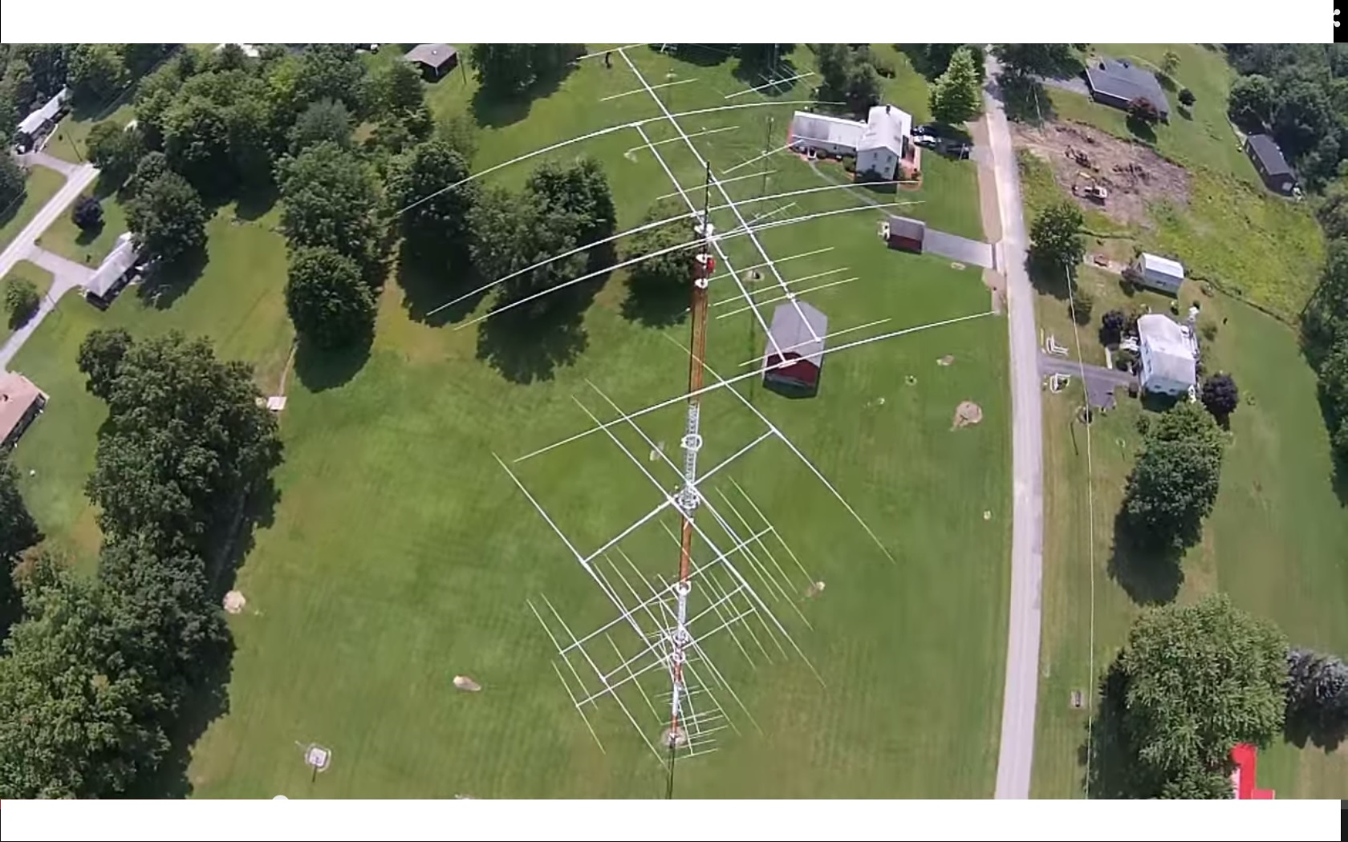

Slide 4
Do it right - or don’t do it
Follow the manufacturers’ design rules
Get advice from others
Be professional (not a cheap ham)

Slide 7
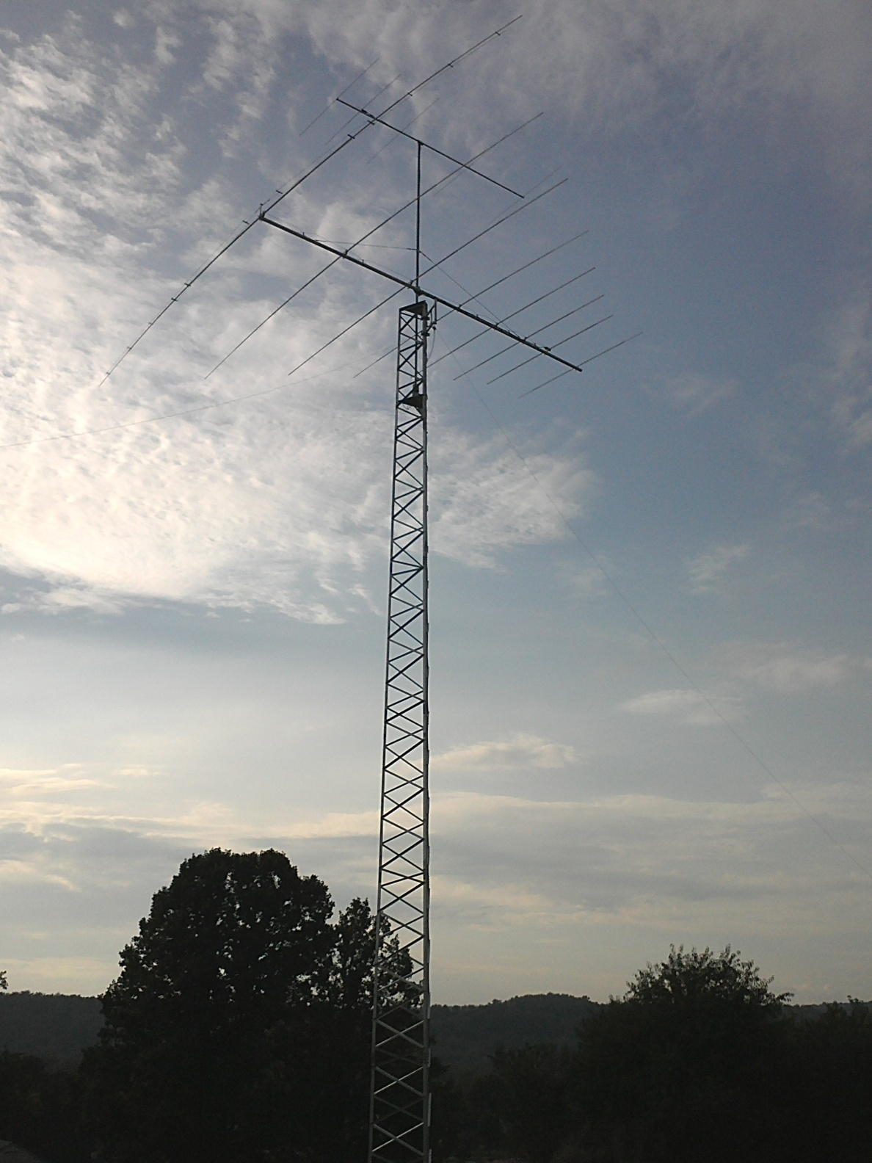

Slide 9
NO SK’s

Slide 10
Some of the risks
Falling
Electrocution
Medical issues while climbing
Structural failure (including crank-up and tilt-over towers)

Slide 11
Use the proper equipment
Watch for power lines!
What about the ground crew?
Take a safety training course

Slide 13
Finally a nice day!

